Slide 1

Partnerships for Learning
at O.L.D. in 2020
Year 4

Slide 2

Prayer
Parents and Teachers
I dreamed I stood in a studio
And watched two sculptors there
The clay they used was a young child’s mind
And they fashioned it with care
One was a teacher, the tools he used
Were books and music and art
One was a parent with a guiding hand
And a gentle loving heart
Day after day the teacher toiled
With a touch that was deft and sure
While the parent labored by his side
And polished and smoothed it over
And when at last the time had passed
They were proud of what they had wrought
For the things they had moulded into the child
Could never be sold or bought
And each agrees they would have failed
If they had worked alone
For behind the parents stood the school
And behind the teacher, the home

Slide 3
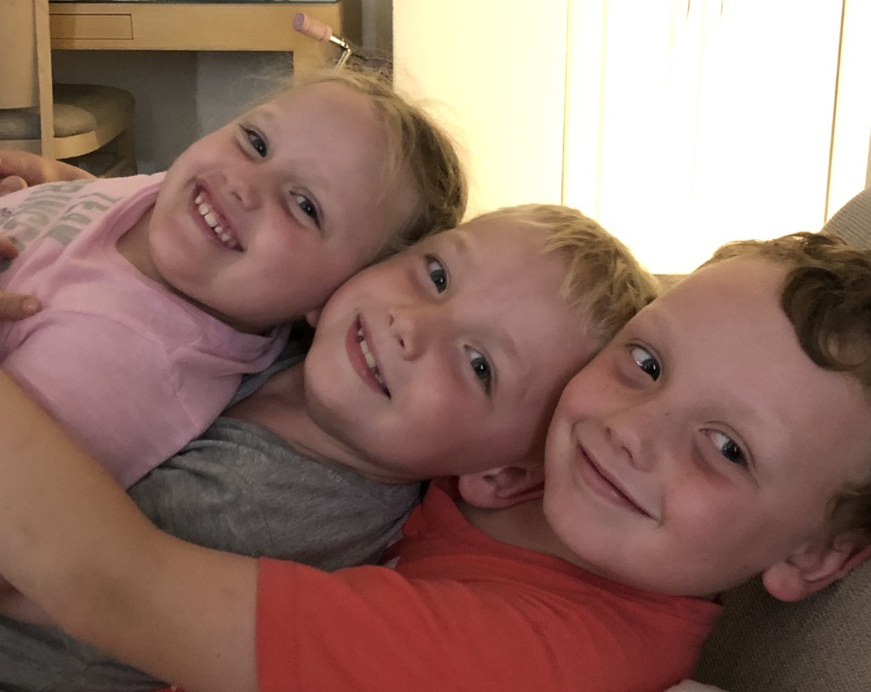
A Little Bit About Us
Mrs Leeanne Taylor
After a career in the travel industry I went back to university to complete a degree in education.
I graduated in 2013 and started my teaching career doing relief teaching.
I have worked at several schools in the Brisbane diocese as a relief teacher and also completed a short term contract at Queen of Apostles Stafford before coming to O.L.D in Term 3 2015.

Slide 4
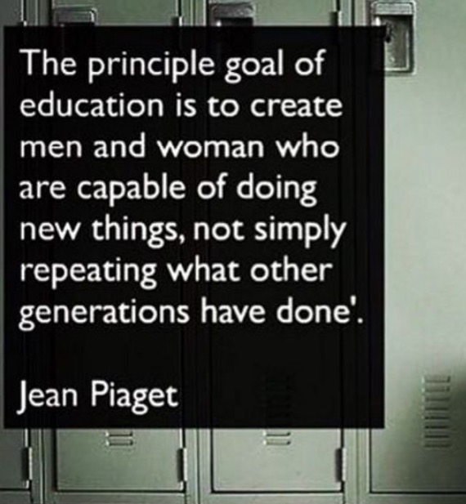
Teaching Philosophy
Every child can learn, make progress and achieve success
I believe that students learn at their own pace and in their own way
I believe in teaching students how to learn rather than what to learn
I believe in curiosity in the classroom and that learning should foster each child’s curiosity about the world
I try to foster an environment that allows students to feel safe and engaged

Slide 5
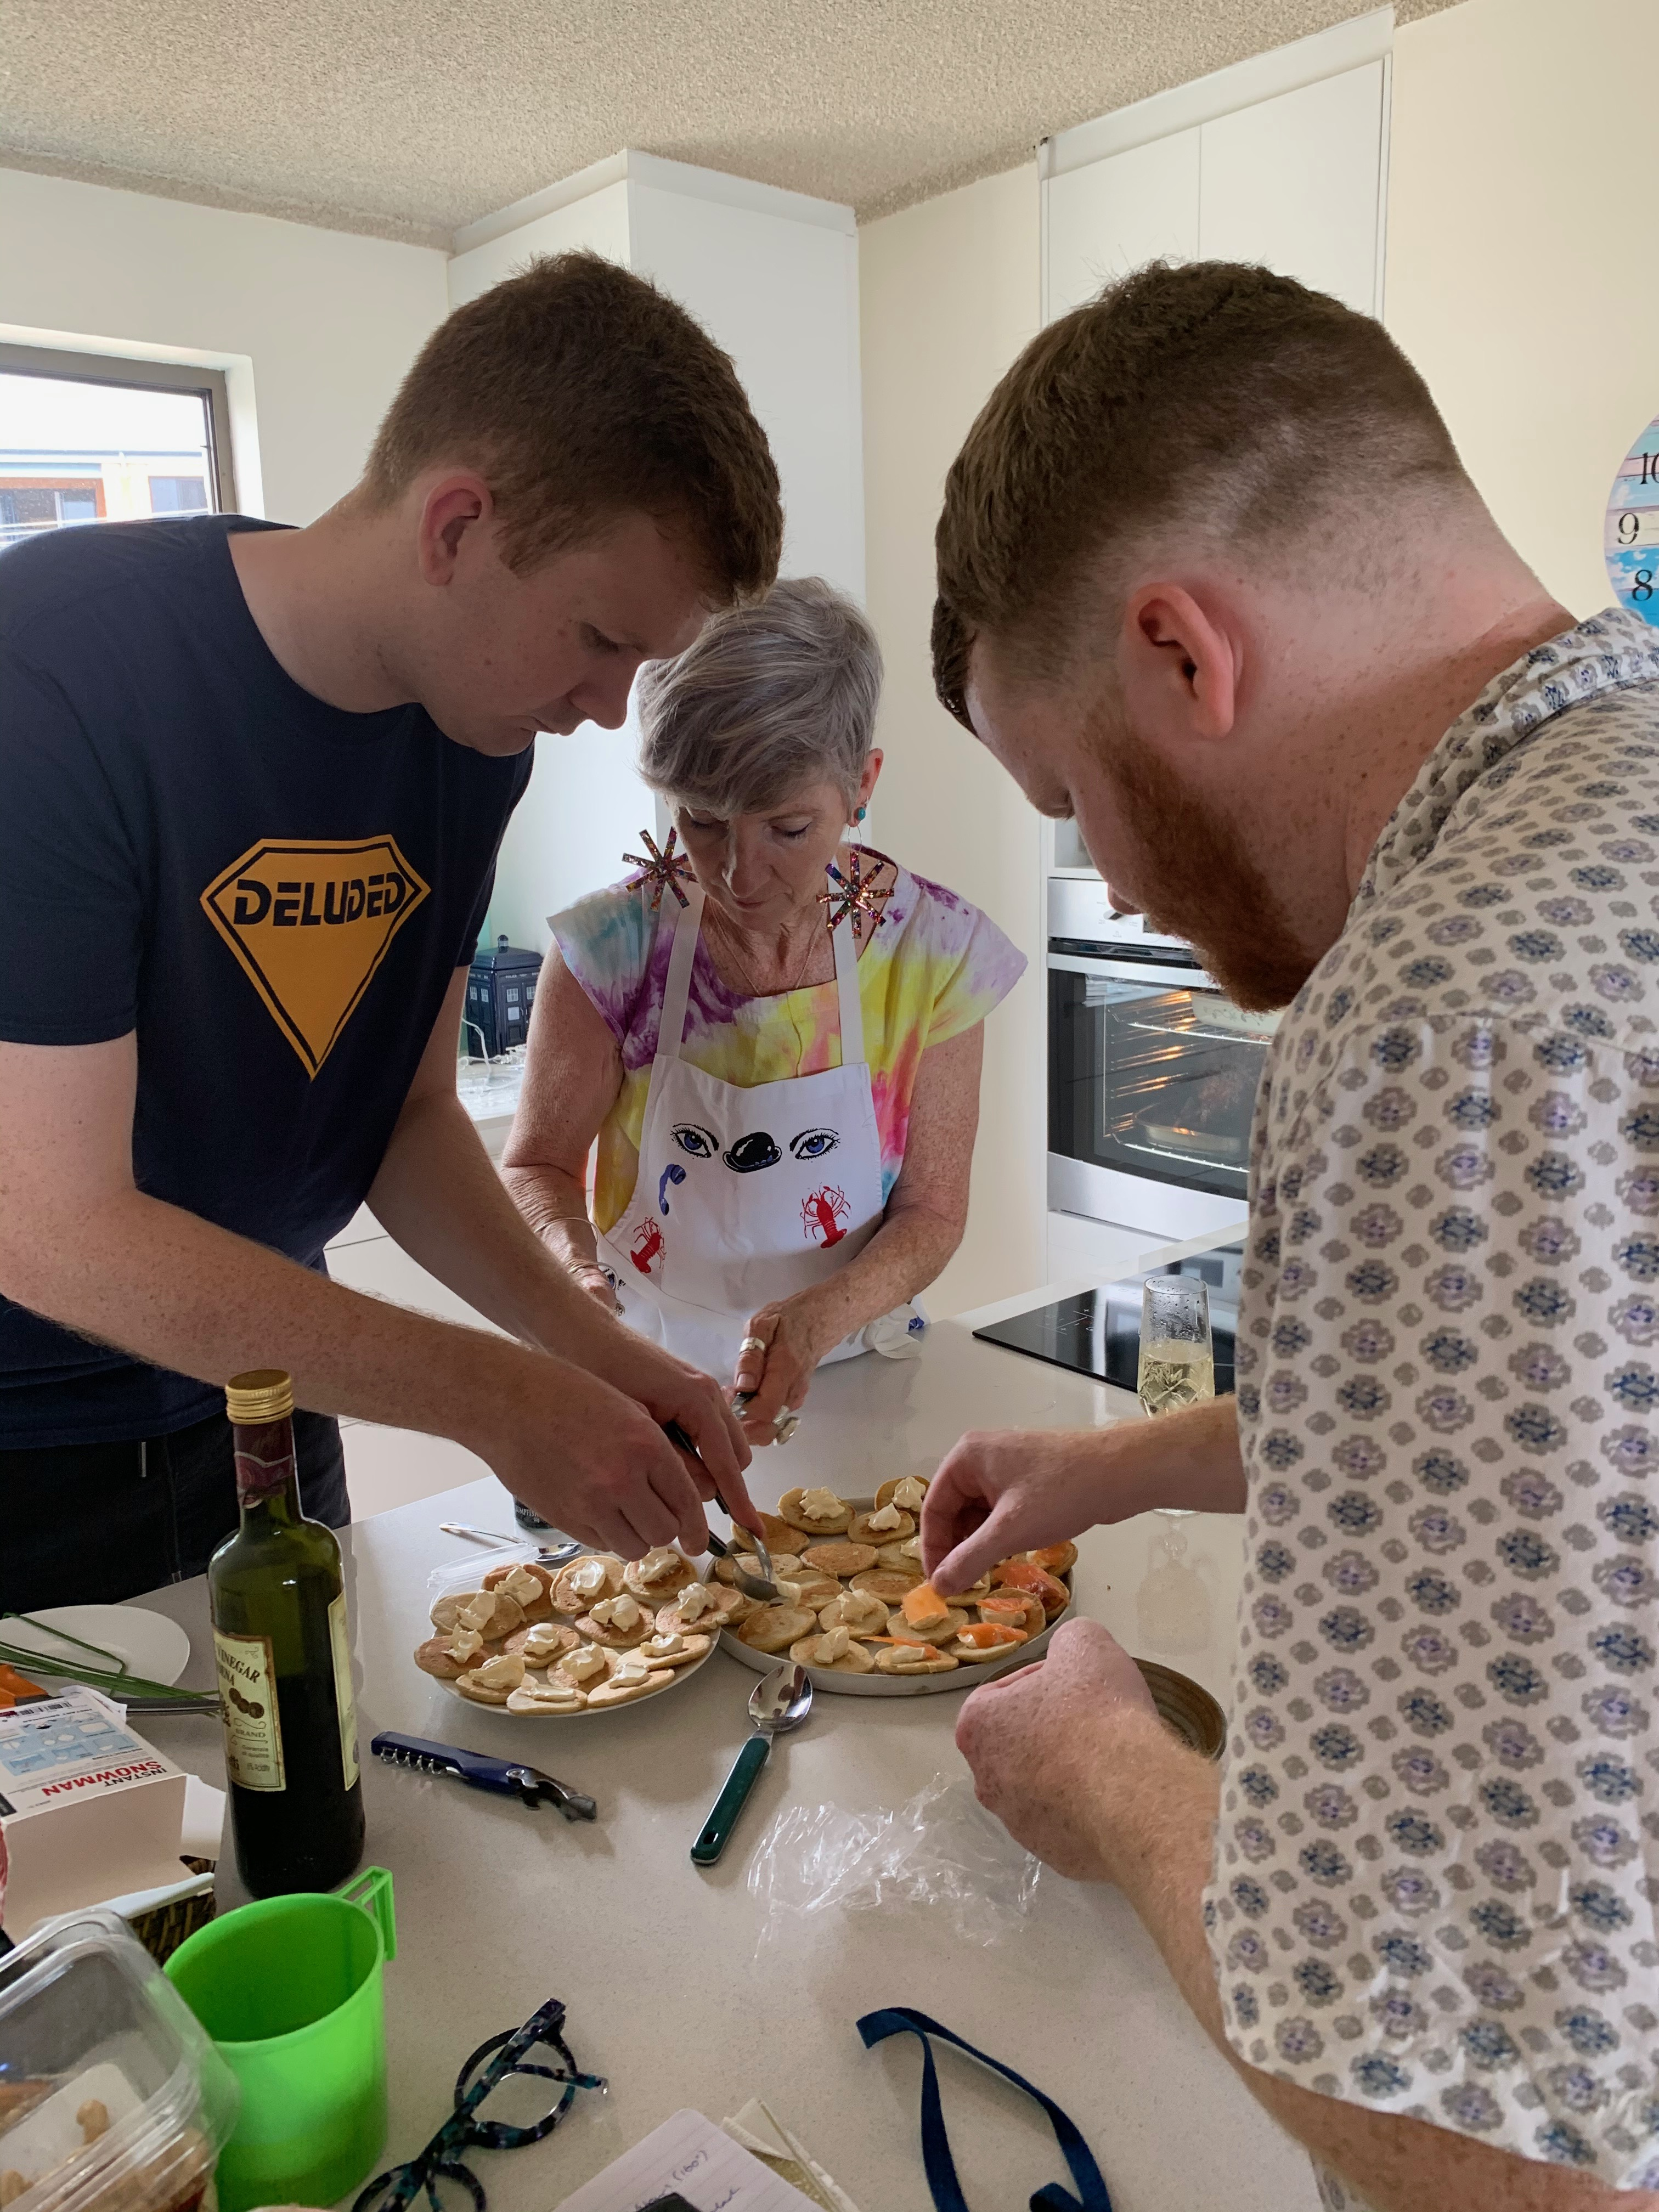
A Little Bit About Us
Ms Mary-Anne Fogarty
After teaching in Qld state schools – Sydney.
Classroom teaching + TL
ESL teaching
ESL Consultant
2004 - moved to Brisbane
ESL teaching
Literacy Numeracy Improvement Teacher
Education Officer Literacy & Numeracy
OLD as Primary Learning Leader in 2016
PHOTO

Slide 6
Teaching Philosophy
Every child is an individual who has his/her own way of learning and thinking
Every child can learn, make progress and achieve success
Learning should be engaging for each child
Learning should foster each child’s curiosity about the world
Each child should feel safe and valued
It is my responsibility to explicitly teach using the Australian Curriculum, reflecting our Catholic beliefs and values

Slide 7
Whole School Teaching and Learning Vision
We believe that all students can think, learn, inquire and create
We believe that all students can get along with and care for others
We believe that all students can act so they can make a difference in the world.
The Kid in the Crest
Think and Learn
Act to Make a Difference
Get along with and care for others

Slide 8



Slide 9
Thinking and Learning
Learning Areas
  Australian Curriculum
    English,
    Mathematics,
    Science,
    HASS (Humanities and Social Sciences)
    Technology;
    Health & Physical Education;
    LOTE - Japanese
    The Arts
      Brisbane Catholic Education
        Religious Education

Slide 10
Thinking and Learning
Specialist Areas
  Physical Education (PE) - 45 minutes Each Monday with Mr Anthony Ebbage
  Music – 30 minutes each Wednesday with Mrs Deanne Johnson
  Art - (Term 1 and 3) with Mrs Therese Flynn-Clarke
  Japanese – 45minutes each Monday
  Swimming Mondays Term 1 weeks 3 – 5 and the carnival in week 6
  Digital Technology – (Term 2 and 4) with Mr Terry Madden

Slide 11
Thinking and Learning
Assessment and Reporting
  Open days;
  Celebration of Learning (Term 1 and Term 3)
  Summative Reports;
  Reflection and Goal setting;
  Parent/Teacher Meetings;
  Samples of work (Portfolio);
  Informal meetings,
  Support Teachers: Inclusive Education (ST:IE)

Slide 12
Thinking and Learning
Supporting Learning
  Differentiated Approach,
  Classroom Adjustments,
  Support and Enrichment,
  School Officers (Mr Cormac Wentrup, Mrs Helen McWhirter, Mrs Sara Lane)
  Mrs Linda Dwyer – Learning Support Teacher

Slide 13
Thinking and Learning
Homework
  Approximately 30 minutes of homework each night
  It is suggested that they also complete 10-20 minutes of reading each night
  No more than 45 minutes per night (Monday to Friday).
  Homework activities should be a revision or continuation of activities completed in class
  No stress or anxiety
Process
  Uploaded to the blog/teams every Friday, submitted the following Friday
  Four compulsory tasks for the week and a selection of optional tasks of which they need to complete at least three.

Slide 15
Developing a language for learning.
What are you learning?
How are you going?
How do you know?
How can you improve?
What do you do when you get stuck?

Slide 16
Ipads
Used daily within the classroom learning activities.
iPad and online etiquette and Cyber Safety.
Students have access to the apps selected by the school
Email access for schoolwork only

Slide 17
Getting along with and Caring for Others
Student Behaviour Support
Multi tiered approach to School Behaviour Support Model
  School
  whole class
  small group
  individual support
The Brisbane Catholic Education Policy on Behaviour Support is used as a basis to develop each individual school Student Behaviour Support Plan. This is based on Positive Behaviour For Learning.
Our SBS Plan has 3 core expectations:
  Strive to Achieve (learning)
  Be Respectful (loving)
  Act Responsibly (living)

Slide 19


Getting along with and Caring for Others
Student Behaviour Support

Slide 20
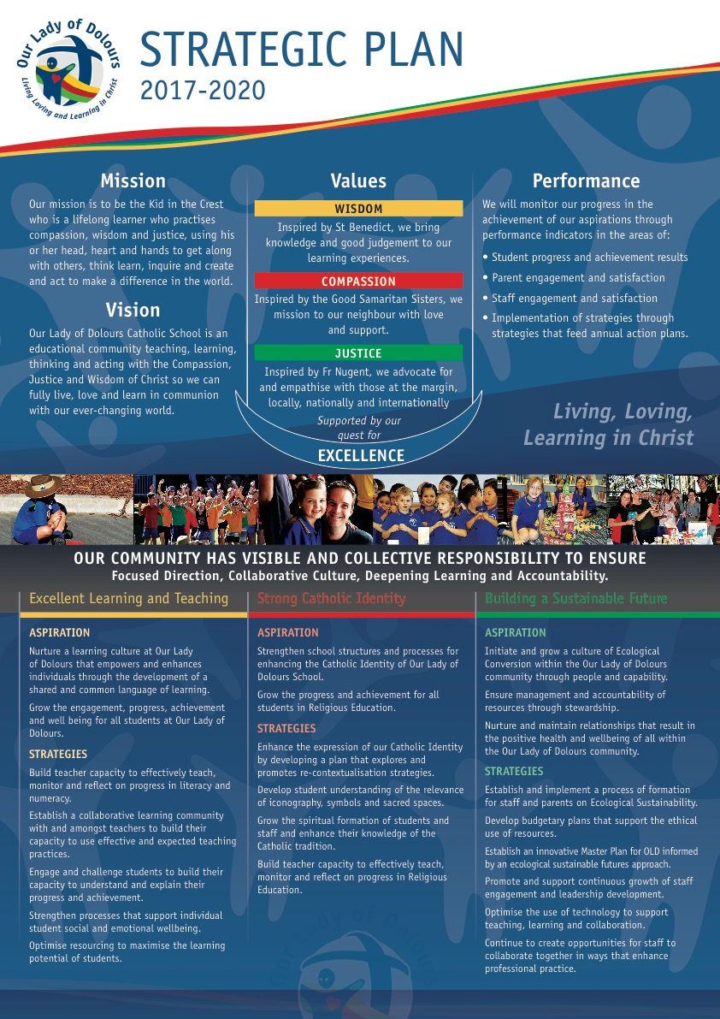

Slide 21
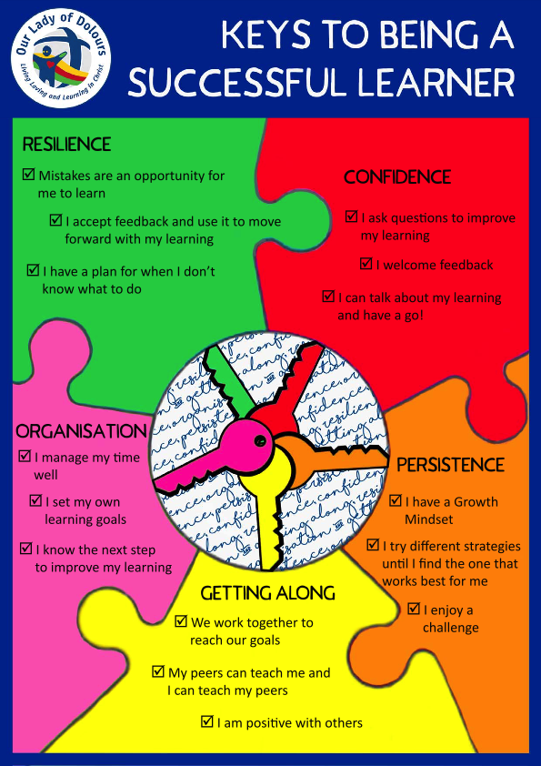

Slide 24
Parent Teacher Communication
  Parent Teacher Interviews – at the end of Term 1.
  Student Led Conversations at the end of Term 3.
  Semester Reports – Twice per Year (end of Term 2 & end of Term 4)
  Email communication pmit@bne.catholic.edu.au Leeanne.M.Taylor@bne.catholic.edu.au and mfogarty@bne.catholic.edu.au
  Class blog/Teams
    Term overview
    Homework
    Photos
    Working space
At any stage throughout the year please feel free to contact me and make an appointment if you have any questions or concerns

Slide 25
Guidance Counselling
Guidance Counsellor (GC) Ms Ruth Blackburn
OLD 2 days a week (Monday and Tuesday)
Can assist with a range of issues that might impact on learning, including:
  Anxiety
  Friendship/social skills
  Grief and loss
  Behavioural concerns
  Learning difficulties

Slide 26
Miscellaneous Matters
Allergies
Celebration of student birthdays – cupcakes or ice blocks/creams
Absences from school – parent portal
SMS notifications will be sent each morning when absence is unexplained.
Pastoral parent – Grace Palmer

Slide 27
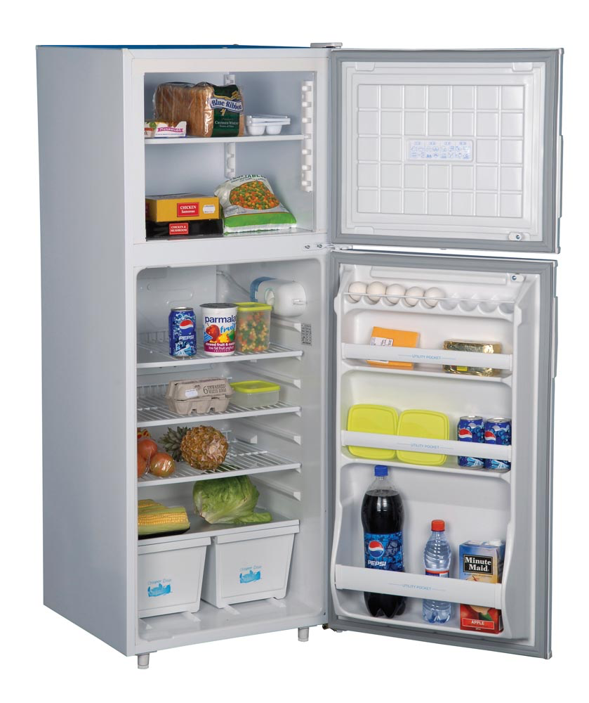

Slide 28
2020 – The Year of St Benedict

Slide 31
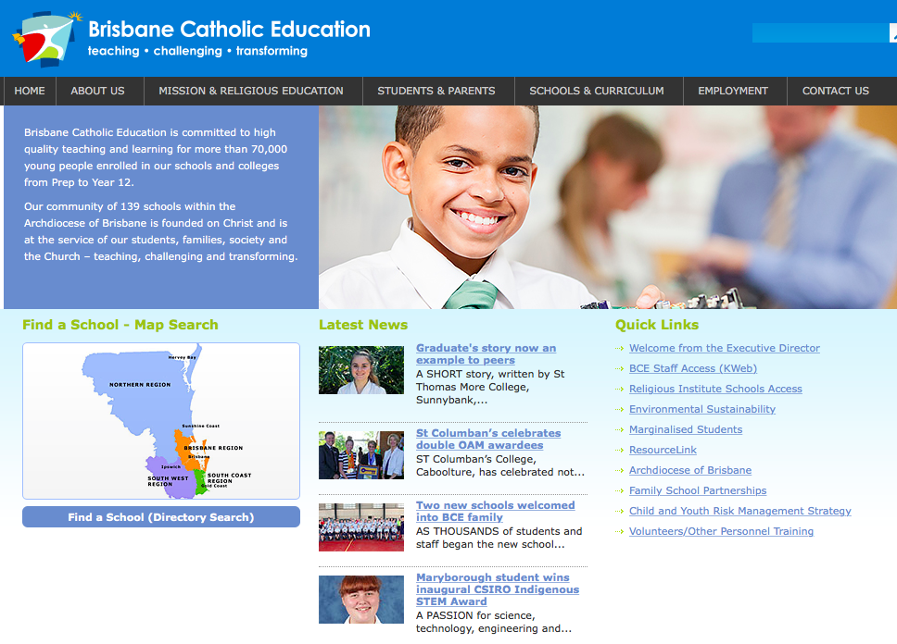
Volunteer Training

Slide 32
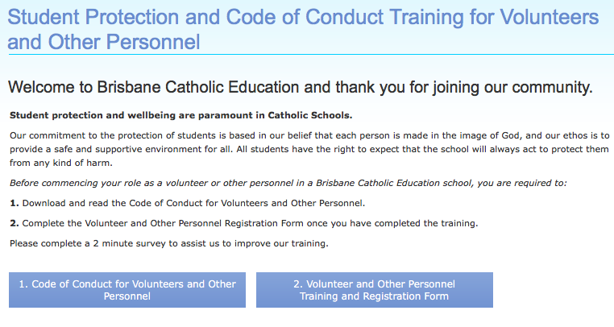
Volunteer Training

